Slide 1
LESSON 13

Slide 2
Overview
of
Previous Lesson(s)

Slide 3
Over View
An NFA accepts a string if the symbols of the string specify a path from the start to an accepting state.
These symbols may specify several paths, some of which lead to accepting states and some that don't.
In such a case the NFA does accept the string, one successful path is enough.
If an edge is labeled ε, then it can be taken for free.

Slide 4
Over View..
A deterministic finite automaton (DFA) is a special case of an NFA where:
There are no moves on input ε, secondly,
For each state S and input symbol a, there is exactly one edge out of s labeled a.

Slide 5

Over View...
Algorithm for converting any RE to an NFA .
The algorithm is syntax- directed, it works recursively up the parse tree for the regular expression.
For each sub-expression the algorithm constructs an NFA with a single accepting state.

Slide 6
Over View...
Method:
Begin by parsing r into its constituent subexpressions.
The rules for constructing an NFA consist of basis rules for handling subexpressions with no operators.
Inductive rules for constructing larger NFA's from the NFA's for the immediate sub expressions of a given expression.

Slide 7


Over View...
Basis Step:
For expression ε construct the NFA
For any sub-expression a in Σ construct the NFA

Slide 8
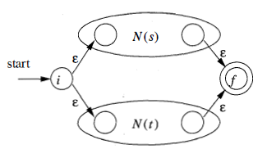
Over View...
Induction Step:
Suppose N(s) and N(t) are NFA's for regular expressions s and t, respectively.
If r = s|t. Then N(r) , the NFA for r, should be constructed as
N(r) accepts L(s) U L(t) , which is the same as L(r) .

Slide 9

Over View...
Now Suppose r = st , Then N(r) , the NFA for r, should be constructed as
N(r) accepts L(s)L(t) , which is the same as L(r) .

Slide 10
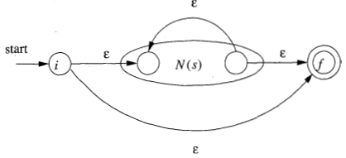
Over View...
Now Suppose r = s* , Then N(r) , the NFA for r, should be constructed as
N(r) accept all the strings in L(s)¹ , L(s)² , and so on , so the entire set of strings accepted by N(r) is L(s*).
Finally suppose r = (s) , Then L(r) = L(s) and we can use the NFA N(s) as N(r).

Slide 11
TODAY’S LESSON

Slide 12
Contents
Design of a Lexical-Analyzer Generator
The Structure of the Generated Analyzer
Pattern Matching Based on NFA 's
DFA's for Lexical Analyzers
Optimization of DFA-Based Pattern Matchers
Important States of an NFA

Slide 13
Lexical-Analyzer Design
Here we will see the designing technique in generating a lexical-analyzer.
We will discuss two approaches, based on NFA's and DFA's.
The program that serves as the lexical analyzer includes a fixed program that simulates an automaton.
The rest of the lexical analyzer consists of components that are created from the Lex program.

Slide 14
Structure of the Generated Analyzer
Its components are:
A transition table for the automaton.
Functions that are passed directly through Lex to the output.
The actions from the input program, which appear as fragments of code to be invoked by the automaton simulator.

Slide 15
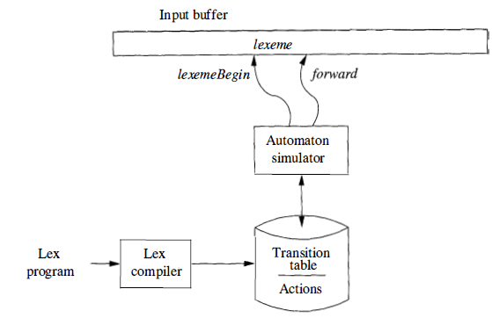
Structure of the Generated Analyzer
Architecture of a lexical analyzer generated by Lex.

Slide 16
Structure of the Generated Analyzer
To construct the automaton, we begin by taking each regular-expression pattern in the Lex program and converting it to an NFA.
We need a single automaton that will recognize lexemes matching any of the patterns in the program.
So we combine all the NFA's into one by introducing a new start state with ɛ-transitions to each of the start states of the NFA's Ni for pattern Pi

Slide 17
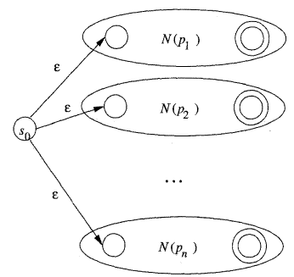
Structure of the Generated Analyzer
An NFA constructed from a Lex program
a { action A₁ for pattern P₁ }
abb { action A₂ for pattern P₂ }
a*b⁺ { action A_{n} for pattern P_{n}}

Slide 18
Pattern Matching Based on NFA 's
For pattern based matching the simulator starts reading characters and calculates the set of states.
At some point the input character does not lead to any state or we have reached the eof.
Since we wish to find the longest lexeme matching the pattern we proceed backwards from the current point (where there was no state) until we reach an accepting state (i.e., the set of NFA states, N-states, contains an accepting N-state).
Each accepting N-state corresponds to a matched pattern.
The lex rule is that if a lexeme matches multiple patterns we choose the pattern listed first in the lex-program.

Slide 19
Pattern Matching Based on NFA's..
Ex. Consider three patterns and their associated actions and consider processing the input aaba.
Pattern Actions to perform
a Action A₁
abb Action A₂
a*b⁺ Action A₃

Slide 20
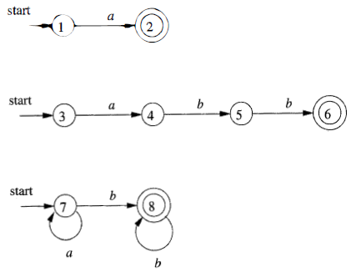
Pattern Matching Based on NFA's…
We begin by constructing the three NFAs.

Slide 21
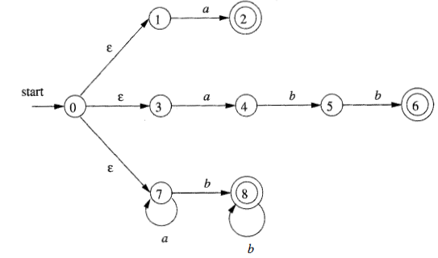
Pattern Matching Based on NFA's…
We introduce a new start state and ε-transitions as discussed in the previous section.

Slide 22
Pattern Matching Based on NFA's…
We start at the ε-closure of the start state, which is {0,1,3,7}.
The first a (remember the input is aaba) takes us to {2,4,7}.
This includes an accepting state and indeed we have matched the first patten. However, we do not stop since we may find a longer match.
The next a takes us to {7} and next b takes us to {8}.
The next a fails since there are no a-transitions out of state 8.

Slide 23
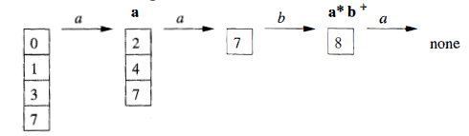
Pattern Matching Based on NFA's…
We are back in {8} and ask if one of these N-states is an accepting state.
Indeed state 8 is accepting for third pattern.
Action3 would now be performed.

Slide 24
DFA for Lexical Analyzer
In this section we see an architecture to convert the NFA for all the patterns into an equivalent DFA, using the subset construction mechanism of DFA from NFA.
Within each DFA state, if there are one or more accepting NFA states, determine the first pattern whose accepting state is represented, and make that pattern the output of the DFA state.

Slide 25
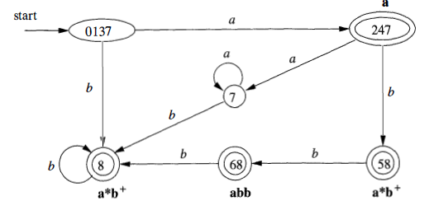
DFA for Lexical Analyzer..
A transition graph for the DFA handling the patterns a, abb and a*b⁺ that is constructed by the subset construction from the NFA.

Slide 26
DFA for Lexical Analyzer…
The accepting states are labeled by the pattern that is matched by that state.
For instance, the state {6, 8 } has two accepting states, corresponding to patterns abb and a*b⁺.
Since the former is listed first, that is the pattern associated with state {6,8}.

Slide 27
DFA for Lexical Analyzer…
In the diagram, when there is no NFA state possible, we do not show the edge.
Technically we should show these edges, all of which lead to the same D-state, called the dead state, and corresponds to the empty subset of N-states.

Slide 28
Optimization of DFA-based Pattern Matchers
Now we will talk about some algorithms that have been used to implement and optimize pattern matchers constructed from regular expressions.
The first algorithm is useful in a Lex compiler, because it constructs a DFA directly from a regular expression, without constructing an intermediate NFA. The resulting DFA also may have fewer states than the DFA constructed via an NFA.

Slide 29
Optimization of DFA-based Pattern Matchers..
The second algorithm minimizes the number of states of any DFA, by combining states that have the same future behavior.
The algorithm itself is quite efficient, running in time O(n log n), where n is the number of states of the DFA.
The third algorithm produces more compact representations of transition tables than the standard, two-dimensional table.

Slide 30
Important States of an NFA
Prior to begin our discussion of how to go directly from a regular expression to a DFA, we must first dissect the NFA construction and consider the roles played by various states.
We call a state of an NFA important if it has a non-ɛ out-transition.
The subset construction uses only the important states in a set T when it computes ɛ- closure (move(T, a)), the set of states reachable from T on input a.

Slide 31
Important States of an NFA..
During the subset construction, two sets of NFA states can be identified if they:
Have the same important states, and
Either both have accepting states or neither does.
The important states are those introduced as initial states in the basis part for a particular symbol position in the regular expression.

Slide 32
Important States of an NFA...
The constructed NFA has only one accepting state, but this state, having no out-transitions, is not an important state.
By concatenating a unique right endmarker # to a regular expression r, we give the accepting state for r a transition on #, making it an important state of the NFA for (r) #.
The important states of the NFA correspond directly to the positions in the regular expression that hold symbols of the alphabet.

Slide 33
Important States of an NFA...
It is useful to present the regular expression by its syntax tree, where the leaves correspond to operands and the interior nodes correspond to operators.
An interior node is called a cat-node, or-node, or star-node if it is labeled by the concatenation operator (dot) , union operator I , or star operator *, respectively.

Slide 34
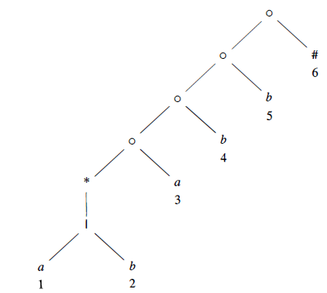
Important States of an NFA...
Ex. Syntax tree for (a|b)*abb#

Slide 35
Thank You

